Slide 1
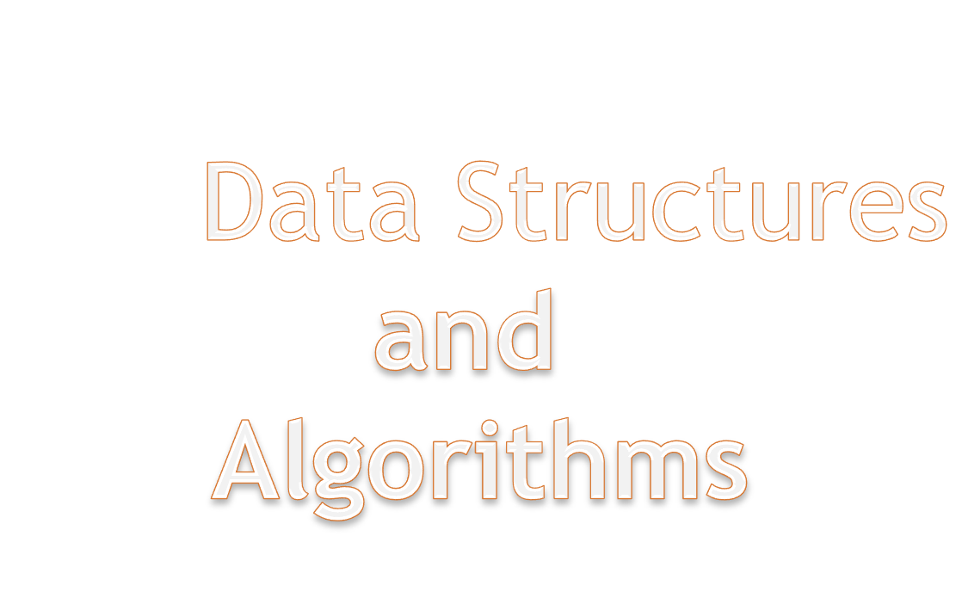
Prof. Manmath N. Sahoo
Dept. of CSE, NIT Rourkela

Slide 2

Data Structures By Seymour Lipschutz [Schaum’s Outline]
An Introduction to Data structures with Applications by Tremblay and Sorenson
Data Structures and Algorithm Analysis in C, 2e By Mark Allen Weiss

Slide 3

Data
Structure
Algorithm

Slide 4
Data are values or a set of values
Data item refers to single unit of values
Data item
  Group item :
    Data item that can be subdivided into sub item.
    Ex Name : First Name, Middle initial and Last Name
  Elementary item:
    Data item that can not be sub divided into sub item Ex : PAN card number / Bank Pass Book Number is treated as single item

Slide 5
Collection of data are frequently organized into a hierarchy of fields, records and files

Slide 6
Entity :
  Something that has certain attributes or properties which may be assigned values
  Values may be numeric or non-numeric
Ex: The employee of an organization
Attributes Name Age Sex Employee Code
Values John 33 M 13472

Slide 7
Entity with similar attributes ( e.g all employees of an organization) form an entity set
Each attribute of an entity set has a range of values [ the set of possible values that could be assigned to the particular attribute]
Information: Data with given attribute or processed data

Slide 8
Field is a single elementary unit of information representing an attribute of an entity
Record is the collection of field values of a given entity
File is the collection of records of the entities in a given entity set

Slide 9

Name | Age | Sex | Roll Number | Branch
A | 17 | M | 109cs0132 | CSE
B | 18 | M | 109ee1234 | EE
C | 19 | F | 109ce0012 | CE
D | 20 | F | 108mm0132 | MM

Slide 10

Record
  Fixed Length
  Variable Length

Slide 11
Study of Data Structure includes the following three steps
  Logical or Mathematical description of the structure
  Implementation of the structure on a computer
  Quantitative analysis of the structure, which includes determining the amount of memory needed to store the structure and the time required to process the structure

Slide 12

A data type is a term which refers to the kind of data that may appear in computation.
Ex: in C
  int, float, char, double, long double, etc.

Slide 13
Data Structure
  The logical or mathematical model of a particular organization of data
Choice of a model depends on two factor
  It must be rich enough in structure to mirror the actual relationships of the data in the real world
  The structure should be simple enough that one can effectively process the data when necessary

Slide 14

A data structure is a way to logically organize data that specifies:
  A set of data elements and
  A set of operations which may legally be applied to elements of this data object.

Slide 15

Data appearing in DS are processed by means of certain operation
Particular DS one chooses for a given situation depends largely on the frequency with which specific operations are performed

Slide 16

Traversing: Accessing each record exactly once so that certain items in the record may be processed
[ Also known as Visiting the record]
Searching: Finding the location of the record with a given key value, or finding the locations of all record which satisfy one or more conditions

Slide 17
Inserting : Adding a new record to the structure
Deleting : Removing a record from the structure

Slide 18
In real life applications, various kind of data other than the primitive data are involved.
Manipulation of real-life data (user data) requires the following essential tasks:
Storage representation of user data: User data should be stored in such a way that computer can understand
Retrieval of stored data: Data stored in a computer should be retrieved in such a way that user can understand.
Transformation of user data: Various operations which require to be performed on user data so that it can be transformed from one form to another.

Slide 19

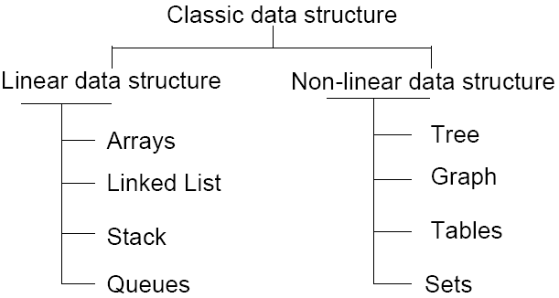

Slide 20
Customer | Salesperson
Adams | Smith
Brown | Ray
Clark | Jones
Drew | Ray
Evans | Smith
Farmer | Jones
Geller | Ray
Hill | Smith

Slide 21
Customer | Pointer
Adams | 3
Brown | 2
Clark | 1
Drew | 2
Evans | 3
Farmer | 1
Geller | 2
Hill | 3
Salesperson
Jones
Ray
Smith

Slide 22
Customer | Pointer
Adams | 3
Brown | 2
Clark | 1
Drew | 2
Evans | 3
Farmer | 1
Geller | 2
Hill | 3
Salesperson | Pointer
Jones | 3,6
Ray | 2,4,7
Smith | 1,5,8

Slide 23
Customer | Pointer
Adams | 5
Brown | 4
Clark | 6
Drew | 7
Evans | 8
Farmer | 0
Geller | 0
Hill | 0
Salesperson | Pointer
Jones | 3
Ray | 2
Smith | 1

